Slide 1

Advanced Corporate Finance (LL4554V/LL5554V/LLJ5554V/LL6554V) 9. capital structures and MM
Kenneth Khoo
kenneth.khoo@nus.edu.sg

Slide 2
Today’s Roadmap
Capital Structure in Perfect Markets (Ch. 16)
MM Proposition 1: firm value is independent of capital structure
How leverage affects EPS, stock prices, and required returns
MM Proposition 2: the cost of equity rises with leverage
How Much Should a Company Borrow? (Ch. 17)
Debt and taxes: the interest tax shield
Limits to tax advantages and personal taxes
Bankruptcy costs and agency costs of debt
Trade-off theory vs. pecking order theory
Capital structure decisions in practice

Slide 3
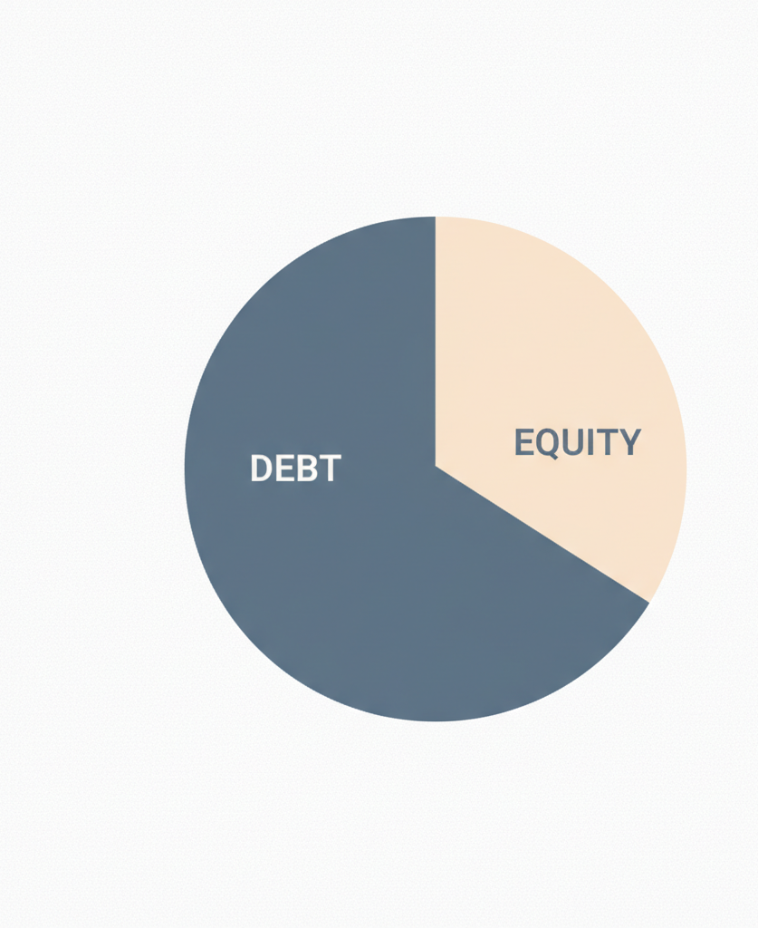
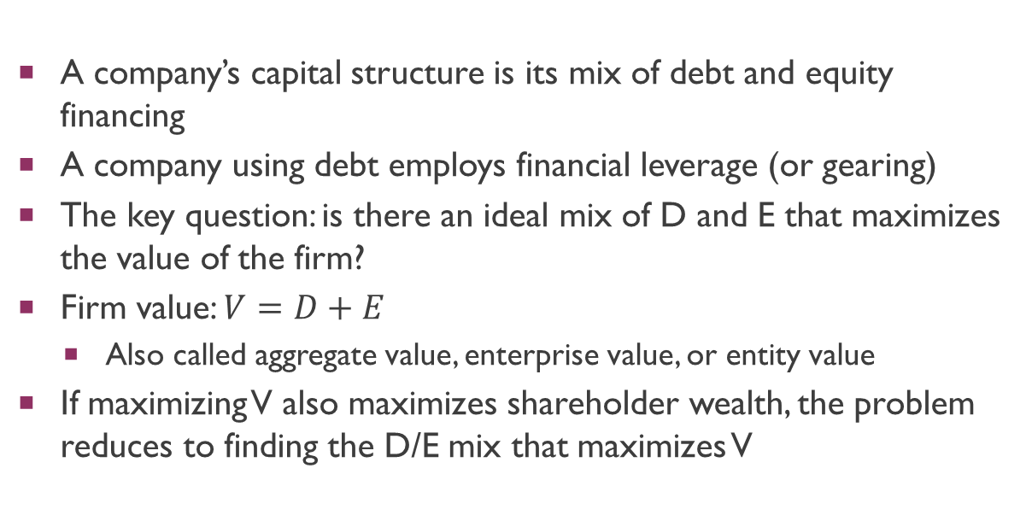
What Is Capital Structure?
A company’s capital structure is its mix of debt and equity financing
A company using debt employs financial leverage (or gearing)
The key question: is there an ideal mix of D and E that maximizes the value of the firm?
Firm value: $V=D+E$
Also called aggregate value, enterprise value, or entity value
If maximizing V also maximizes shareholder wealth, the problem reduces to finding the D/E mix that maximizes V

Slide 4
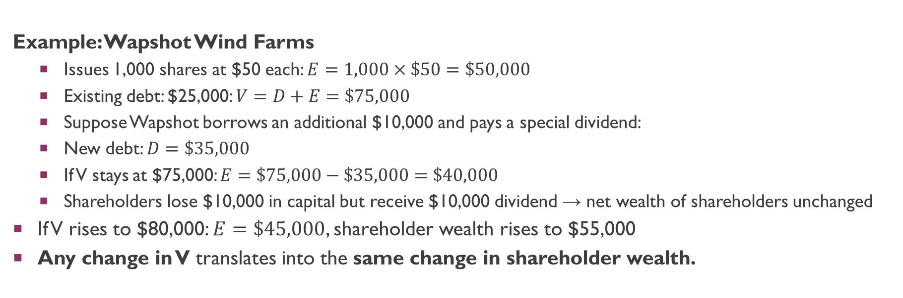
Capital Structure and Firm Value
Example: Wapshot Wind Farms
Issues 1,000 shares at $50 each: $E=1,000×\$50=\$50,000$
Existing debt: $25,000: $V=D+E=\$75,000$
Suppose Wapshot borrows an additional $10,000 and pays a special dividend:
New debt: $D=\$35,000$
If V stays at $75,000: $E=\$75,000−\$35,000=\$40,000$
Shareholders lose $10,000 in capital but receive $10,000 dividend → net wealth of shareholders unchanged
If V rises to $80,000: $E=\$45,000$, shareholder wealth rises to $55,000
Any change in V translates into the same change in shareholder wealth.

Slide 5
Why Maximizing V Maximizes Shareholder Wealth
Debtholders are unaffected by changes in capital structure
New debt is issued (or retired) at fair market terms → zero-NPV transaction for debtholders
Therefore any increase or decrease in V goes entirely to shareholders
Key result: the capital structure that maximizes firm value also maximizes shareholder wealth
Two important assumptions:
Shareholder value is independent of payout policy (Ch. 15)
The value of existing debt is unchanged by new borrowing [re-eamined later]

Slide 6
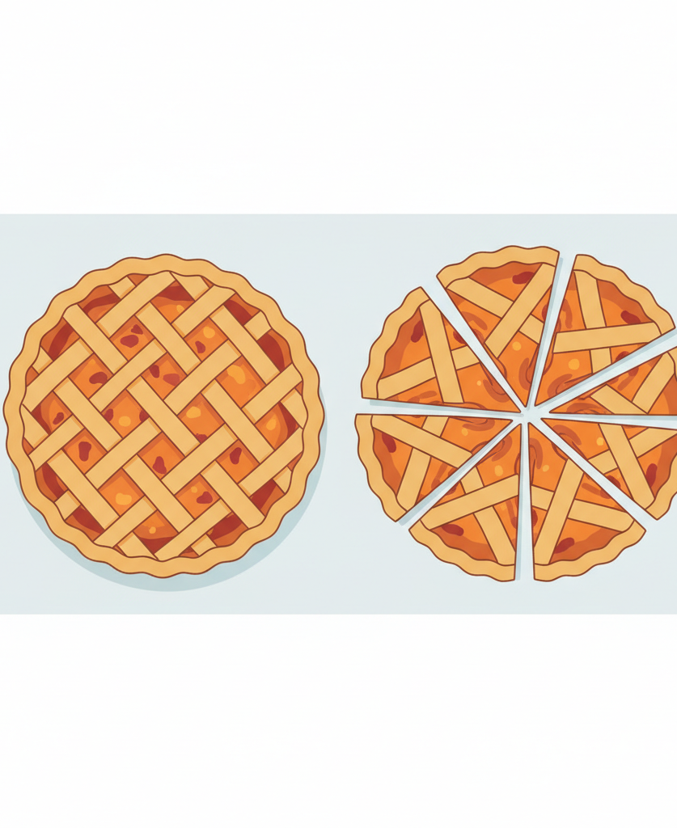
Modigliani and Miller’s Proposition 1
MM Proposition 1 (1958):
In perfect capital markets, and given a fixed set of unlevered cash flows, the value of a firm is independent of its capital structure
A firm’s value depends on its assets (what it does), not on how it is financed
Products, services, corporate culture, brand, growth opportunities
Analogy: the price of a house depends on its location, size, and condition — not on how much mortgage its owner has
Perfect capital market assumptions:
No taxes, no bankruptcy costs, no transaction costs
Investors can borrow and lend at the same rate as firms
Symmetric information between managers and investors
Newly issued securities are fairly priced (zero-NPV transactions)

Slide 7
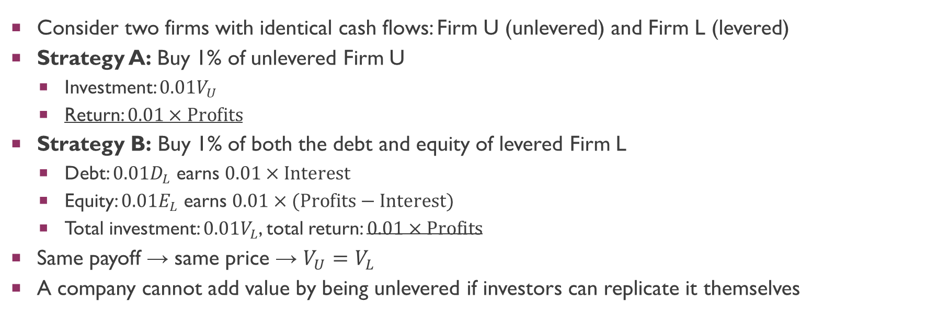
The DIY Principle: Low-Risk Strategy
Consider two firms with identical cash flows: Firm U (unlevered) and Firm L (levered)
Strategy A: Buy 1% of unlevered Firm U
Investment: $0.01V_{U}$
Return: $0.01×\text{Profits}$
Strategy B: Buy 1% of both the debt and equity of levered Firm L
Debt: $0.01D_{L}$ earns $0.01×\text{Interest}$
Equity: $0.01E_{L}$ earns $0.01×(\text{Profits}−\text{Interest})$
Total investment: $0.01V_{L}$, total return: $0.01×\text{Profits}$
Same payoff → same price → $V_{U}=V_{L}$
A company cannot add value by being unlevered if investors can replicate it themselves

Slide 8
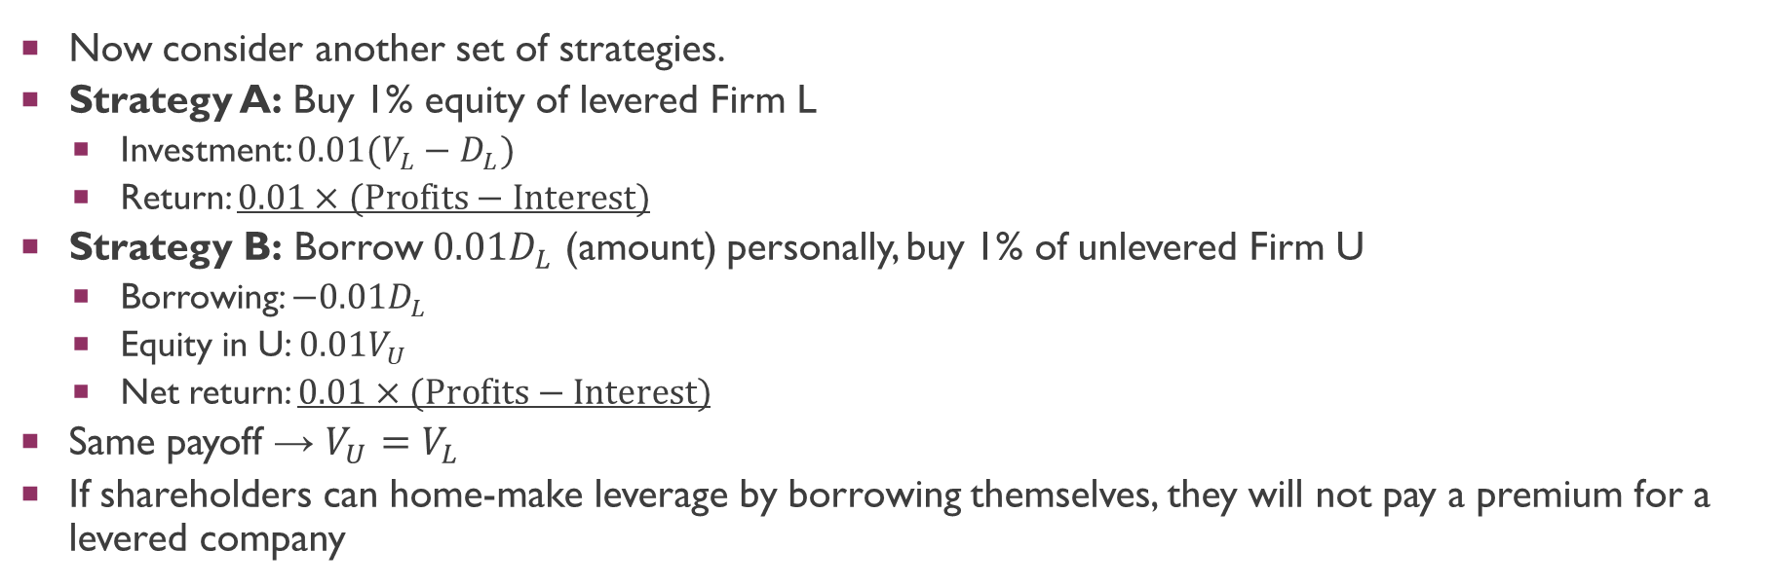
The DIY Principle: High-Risk Strategy
Now consider another set of strategies.
Strategy A: Buy 1% equity of levered Firm L
Investment: $0.01(V_{L}−D_{L})$
Return: $0.01×(\text{Profits}−\text{Interest})$
Strategy B: Borrow $0.01D_{L}$ (amount) personally, buy 1% of unlevered Firm U
Borrowing: $−0.01D_{L}$
Equity in U: $0.01V_{U}$
Net return: $0.01×(\text{Profits}−\text{Interest})$
Same payoff → $V_{U}=V_{L}$
If shareholders can home-make leverage by borrowing themselves, they will not pay a premium for a levered company

Slide 9
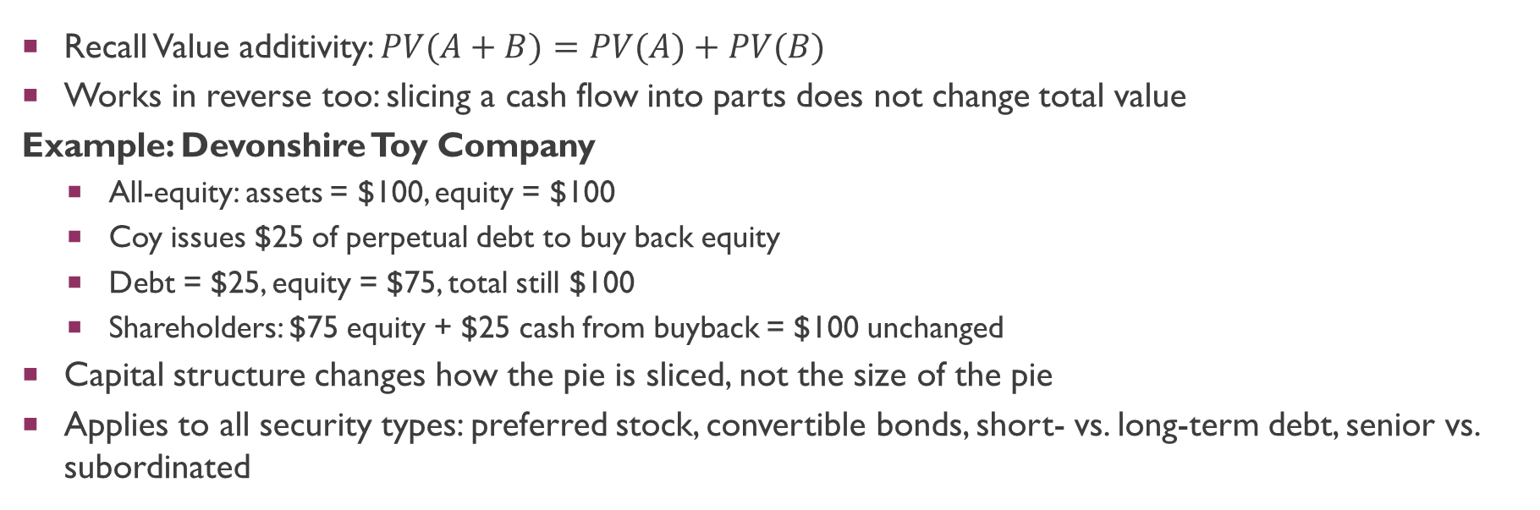
The Law of Conservation of Value
Recall Value additivity: $PV(A+B)=PV(A)+PV(B)$
Works in reverse too: slicing a cash flow into parts does not change total value
Example: Devonshire Toy Company
All-equity: assets = $100, equity = $100
Coy issues $25 of perpetual debt to buy back equity
Debt = $25, equity = $75, total still $100
Shareholders: $75 equity + $25 cash from buyback = $100 unchanged
Capital structure changes how the pie is sliced, not the size of the pie
Applies to all security types: preferred stock, convertible bonds, short- vs. long-term debt, senior vs. subordinated

Slide 10
Implications of MM Proposition 1
A firm’s value depends entirely on its assets, not its financing
Investment decisions can be completely separated from financing decisions
Use all-equity WACC to evaluate projects — ignore how the project is financed
Financial managers should focus on positive-NPV investments, not financial engineering
Why study capital structure if it’s irrelevant?
Because in reality, markets are NOT perfect
Taxes, bankruptcy costs, and agency costs all matter (Ch. 17)
MM gives us the starting point: structure can only matter due to market imperfections

Slide 11
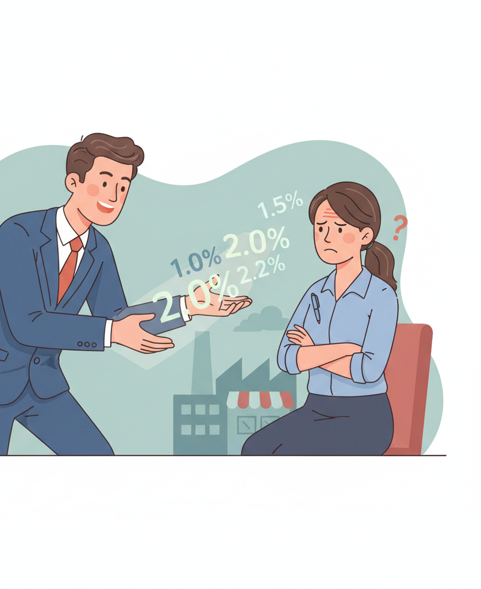
The “Cheap Debt” Fallacy
A common but WRONG argument for leverage:
“Debt costs 10%. Equity costs 15%. Use more cheap debt to lower your overall cost of capital.”
This logic ignores what happens to the cost of equity when you add debt
As leverage rises, equity becomes riskier → shareholders demand a higher return
The “savings” from cheap debt are offset by the rising cost of equity
MM showed: in perfect markets, WACC is constant regardless of leverage
The Macbeth Spot Removers example illustrates this point.

Slide 12
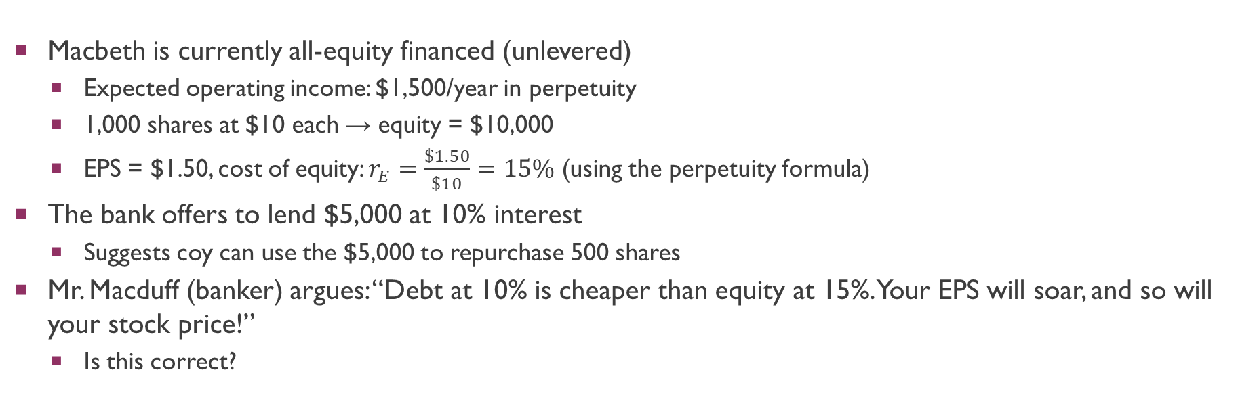
Macbeth Spot Removers: Setup
Macbeth is currently all-equity financed (unlevered)
Expected operating income: $1,500/year in perpetuity
1,000 shares at $10 each → equity = $10,000
EPS = $1.50, cost of equity: $r_{E}=\frac{\$1.50}{\$10}=15\%$ (using the perpetuity formula)
The bank offers to lend $5,000 at 10% interest
Suggests coy can use the $5,000 to repurchase 500 shares
Mr. Macduff (banker) argues: “Debt at 10% is cheaper than equity at 15%. Your EPS will soar, and so will your stock price!”
Is this correct?

Slide 13
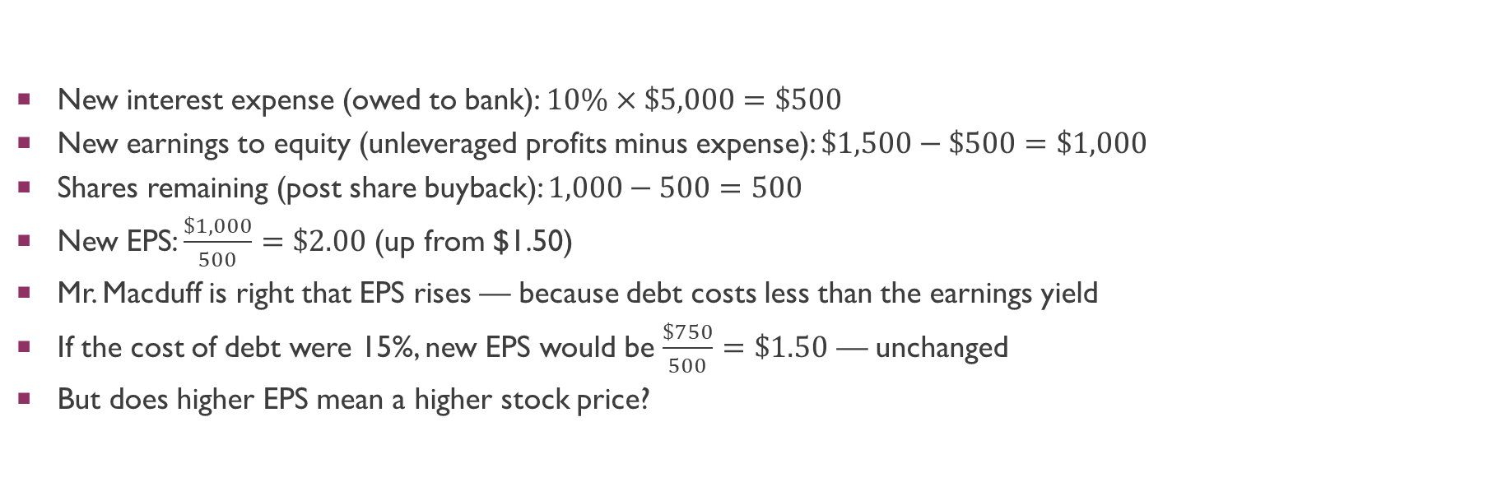
Macbeth: EPS After Levering Up
New interest expense (owed to bank): $10\%×\$5,000=\$500$
New earnings to equity (unleveraged profits minus expense): $\$1,500−\$500=\$1,000$
Shares remaining (post share buyback): $1,000−500=500$
New EPS: $\frac{\$1,000}{500}=\$2.00$ (up from $1.50)
Mr. Macduff is right that EPS rises — because debt costs less than the earnings yield
If the cost of debt were 15%, new EPS would be $\frac{\$750}{500}=\$1.50$ — unchanged
But does higher EPS mean a higher stock price?

Slide 14
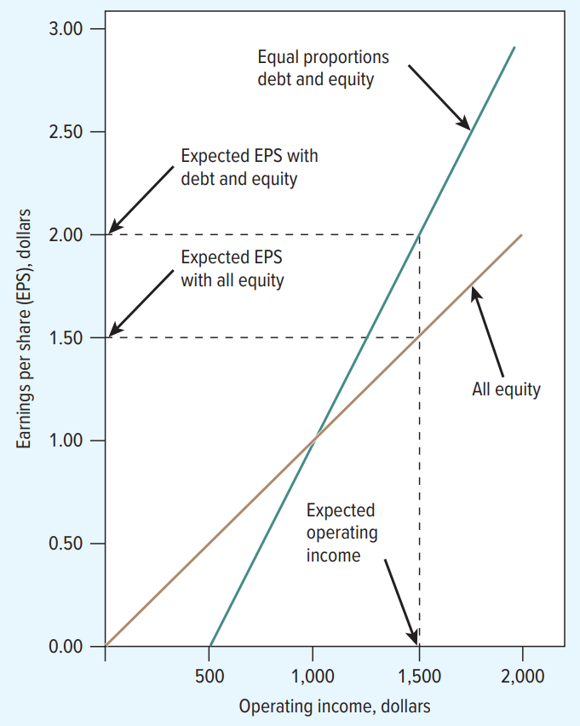
How Leverage Affects Operating Income and EPS
Unlevered (brown line):
EPS ranges $0.50 – $2.00 (see textbook)
Expected EPS = $1.50
Levered 50/50 (blue line):
EPS ranges $0 – $3.00 (see textbook)
Expected EPS = $2.00
Leverage amplifies both upside AND downside
Crossover at operating income = $1,000

Slide 15
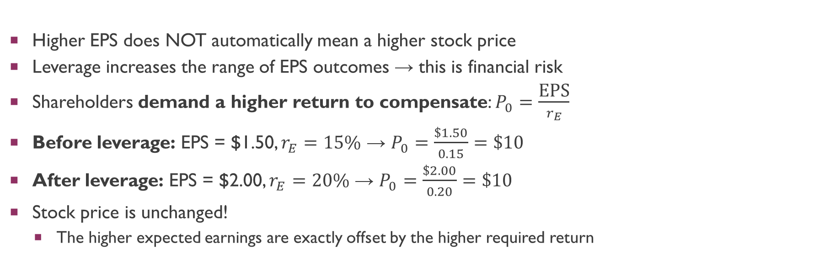
Why the Stock Price Is Unchanged
Higher EPS does NOT automatically mean a higher stock price
Leverage increases the range of EPS outcomes → this is financial risk
Shareholders demand a higher return to compensate: $P_{0}=\frac{\text{EPS}}{r_{E}}$
Before leverage: EPS = $1.50, $r_{E}=15\%$ → $P_{0}=\frac{\$1.50}{0.15}=\$10$
After leverage: EPS = $2.00, $r_{E}=20\%$ → $P_{0}=\frac{\$2.00}{0.20}=\$10$
Stock price is unchanged!
The higher expected earnings are exactly offset by the higher required return

Slide 16
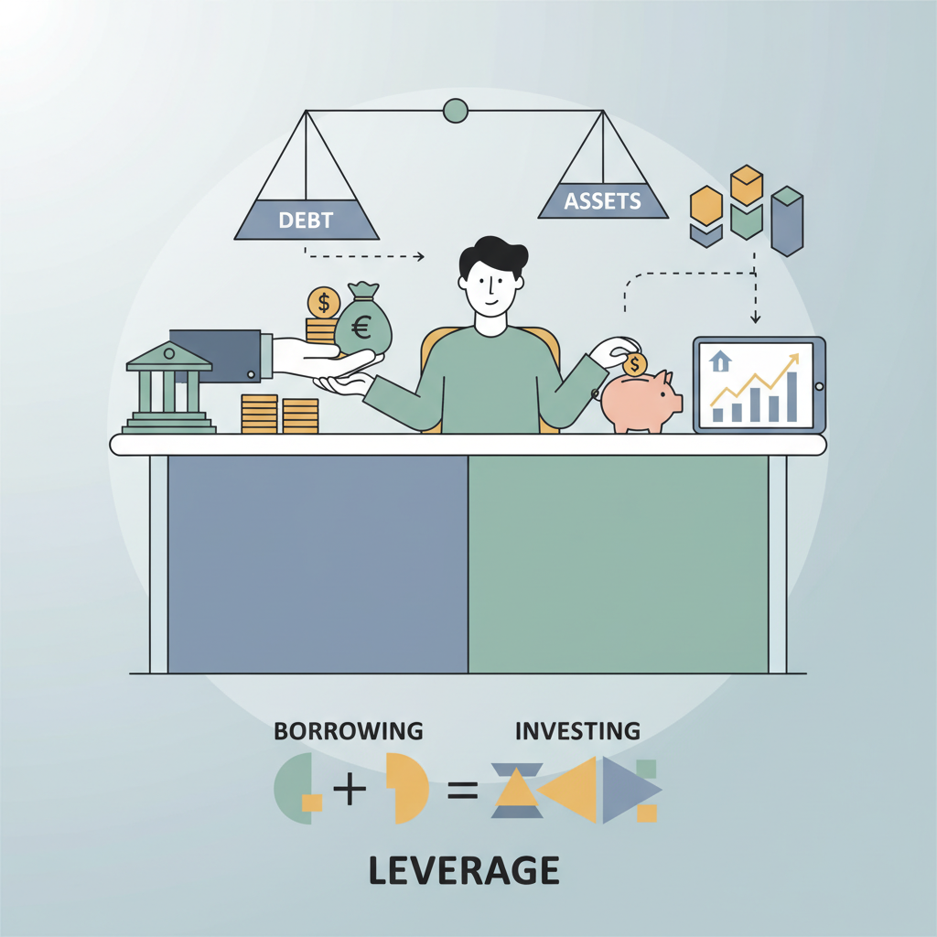
Home-Made Leverage
If an investor wants more leverage, she can create it herself
Example: invest $10 of own money, borrow $10, buy 2 unlevered Macbeth shares
Earnings on 2 shares: $1.00 – $4.00 depending on outcome (double 0.50-2 dollars—see textbook)
Less personal interest at 10%: $1.00
Net earnings: $0 – $3.00 on $10 invested
This exactly replicates owning 1 share of the levered company
Since investors can home-make leverage, corporate leverage cannot add value
This is the DIY Principle at work — the same argument MM used to prove Proposition 1.

Slide 17
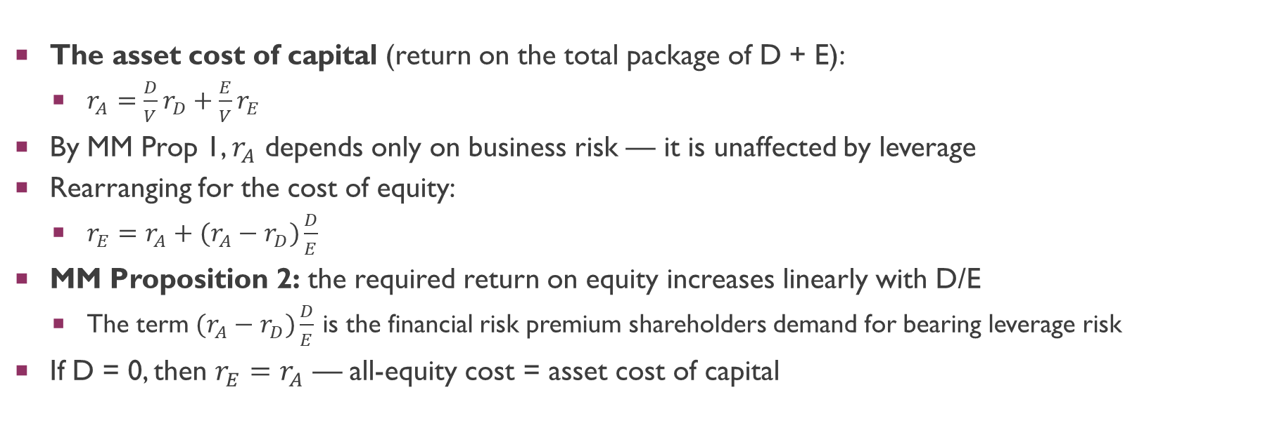
Deriving MM Proposition 2
The asset cost of capital (return on the total package of D + E):
$r_{A}=\frac{D}{V}r_{D}+\frac{E}{V}r_{E}$
By MM Prop 1, $r_{A}$ depends only on business risk — it is unaffected by leverage
Rearranging for the cost of equity:
$r_{E}=r_{A}+(r_{A}−r_{D})\frac{D}{E}$
MM Proposition 2: the required return on equity increases linearly with D/E
The term $(r_{A}−r_{D})\frac{D}{E}$ is the financial risk premium shareholders demand for bearing leverage risk
If D = 0, then $r_{E}=r_{A}$ — all-equity cost = asset cost of capital

Slide 18
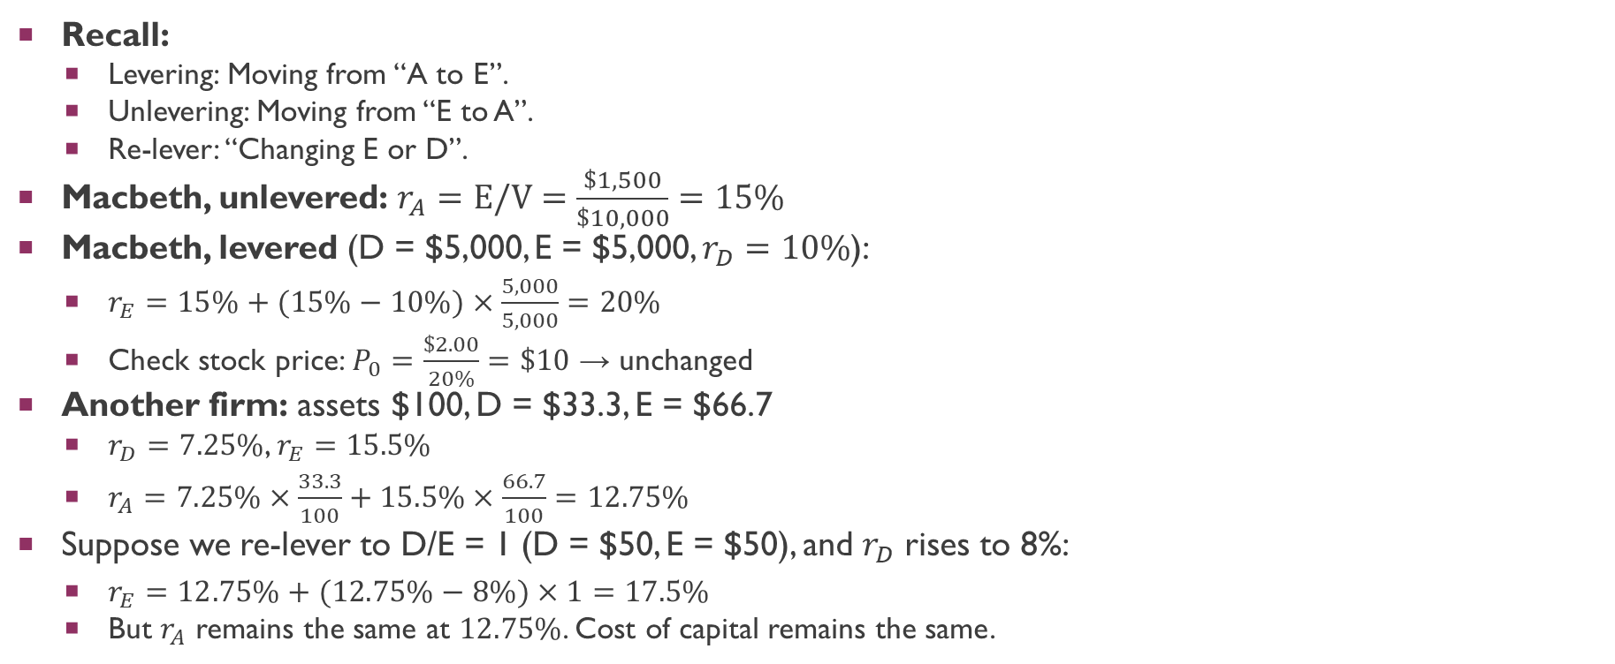
MM Proposition 2: Numerical Example
Recall:
Levering: Moving from “A to E”.
Unlevering: Moving from “E to A”.
Re-lever: “Changing E or D”.
Macbeth, unlevered: $r_{A}=E/V=\frac{\$1,500}{\$10,000}=15\%$
Macbeth, levered (D = $5,000, E = $5,000, $r_{D}=10\%$):
$r_{E}=15\%+(15\%−10\%)×\frac{5,000}{5,000}=20\%$
Check stock price: $P_{0}=\frac{\$2.00}{20\%}=\$10$ → unchanged
Another firm: assets $100, D = $33.3, E = $66.7
$r_{D}=7.25\%$, $r_{E}=15.5\%$
$r_{A}=7.25\%×\frac{33.3}{100}+15.5\%×\frac{66.7}{100}=12.75\%$
Suppose we re-lever to D/E = 1 (D = $50, E = $50), and $r_{D}$ rises to 8%:
$r_{E}=12.75\%+(12.75\%−8\%)×1=17.5\%$
But $r_{A}$ remains the same at $12.75\%$. Cost of capital remains the same.

Slide 19
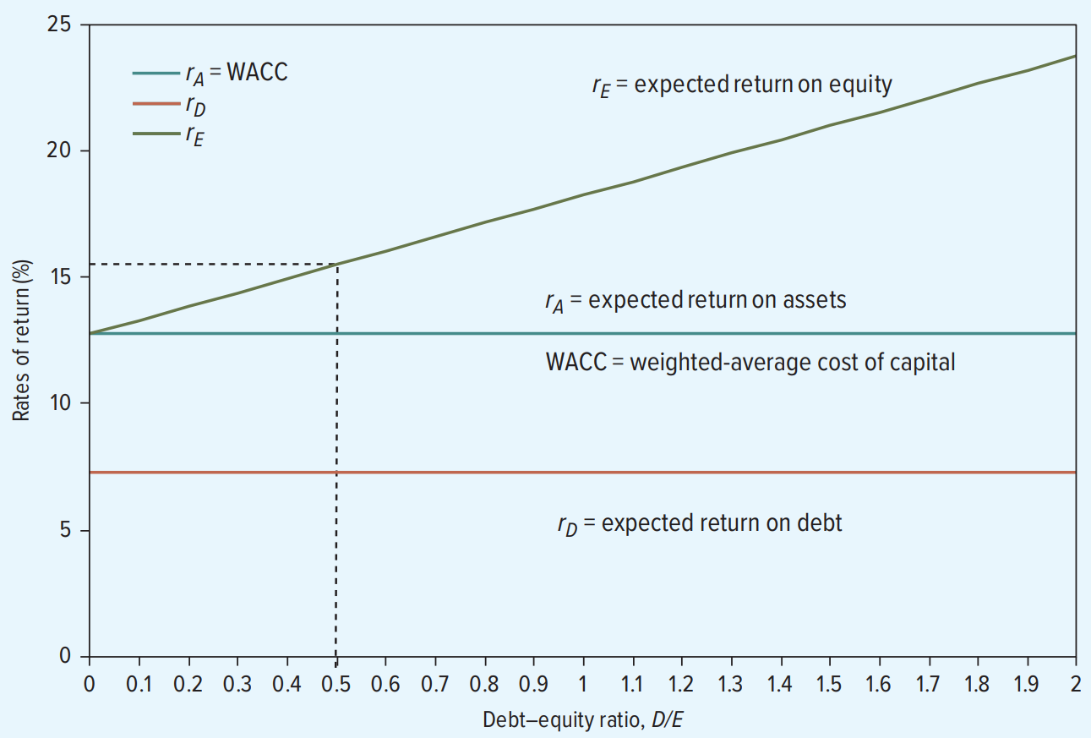
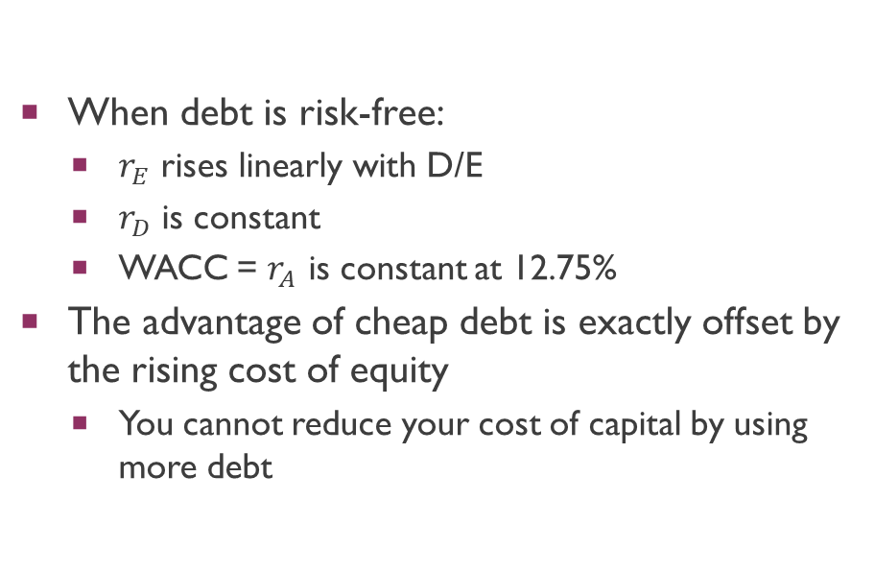
Leverage and the Cost of Capital
When debt is risk-free:
$r_{E}$ rises linearly with D/E
$r_{D}$ is constant
WACC = $r_{A}$ is constant at 12.75%
The advantage of cheap debt is exactly offset by the rising cost of equity
You cannot reduce your cost of capital by using more debt

Slide 20
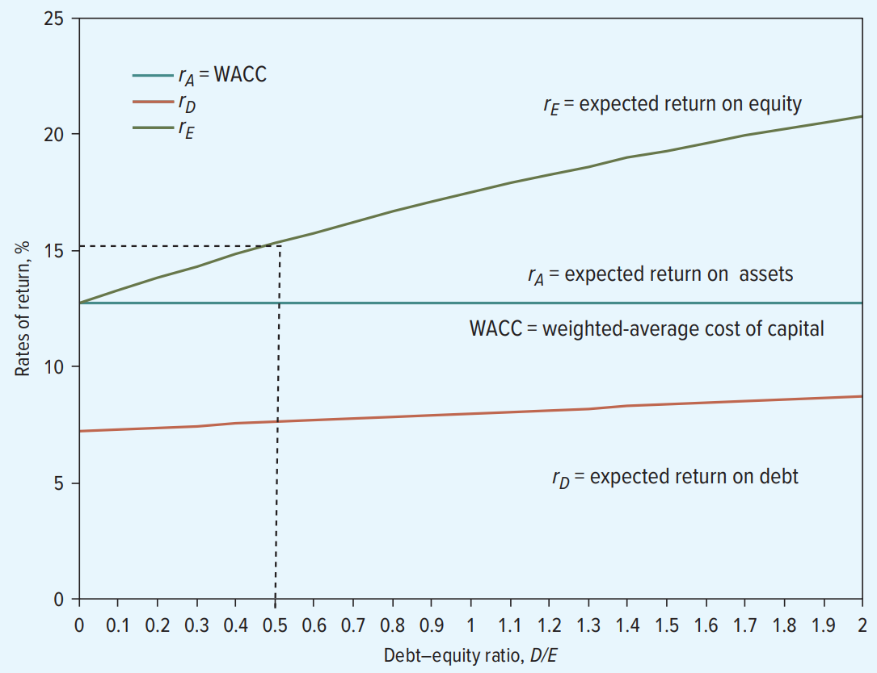
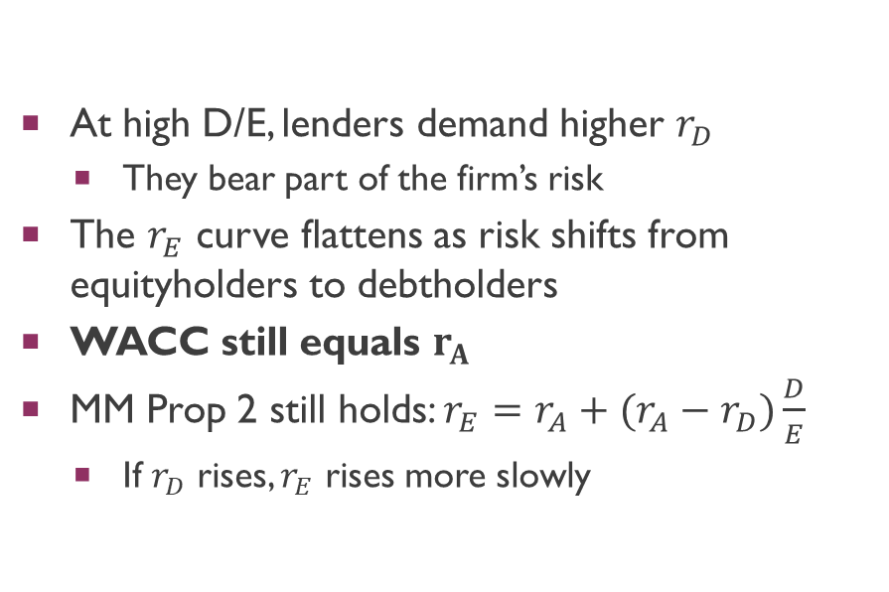
When Leverage Increases the Cost of Debt
At high D/E, lenders demand higher $r_{D}$
They bear part of the firm’s risk
The $r_{E}$ curve flattens as risk shifts from equityholders to debtholders
WACC still equals $r_{A}$
MM Prop 2 still holds: $r_{E}=r_{A}+(r_{A}−r_{D})\frac{D}{E}$
If $r_{D}$ rises, $r_{E}$ rises more slowly

Slide 21
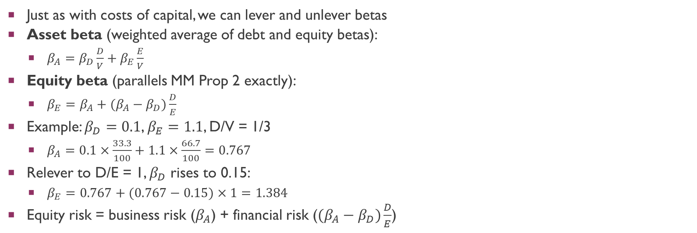
Levering and Unlevering Betas
Just as with costs of capital, we can lever and unlever betas
Asset beta (weighted average of debt and equity betas):
$β_{A}=β_{D}\frac{D}{V}+β_{E}\frac{E}{V}$
Equity beta (parallels MM Prop 2 exactly):
$β_{E}=β_{A}+(β_{A}−β_{D})\frac{D}{E}$
Example: $β_{D}=0.1$, $β_{E}=1.1$, D/V = 1/3
$β_{A}=0.1×\frac{33.3}{100}+1.1×\frac{66.7}{100}=0.767$
Relever to D/E = 1, $β_{D}$ rises to 0.15:
$β_{E}=0.767+(0.767−0.15)×1=1.384$
Equity risk = business risk ($β_{A}$) + financial risk ($(β_{A}−β_{D})\frac{D}{E}$)

Slide 22
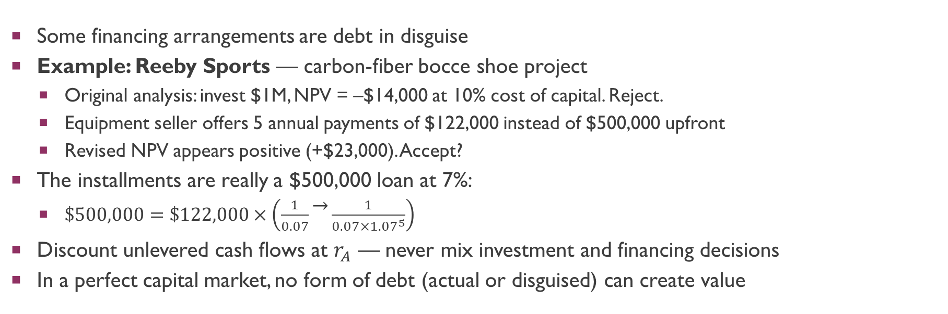
Watch Out for Hidden Leverage
Some financing arrangements are debt in disguise
Example: Reeby Sports — carbon-fiber bocce shoe project
Original analysis: invest $1M, NPV = –$14,000 at 10% cost of capital. Reject.
Equipment seller offers 5 annual payments of $122,000 instead of $500,000 upfront
Revised NPV appears positive (+$23,000). Accept?
The installments are really a $500,000 loan at 7%:
$\$500,000=\$122,000×\left(\frac{1}{0.07} − \frac{1}{0.07×{1.07}^{5}}\right)$
Discount unlevered cash flows at $r_{A}$ — never mix investment and financing decisions
In a perfect capital market, no form of debt (actual or disguised) can create value

Slide 23

Why Capital Structure Matters in Practice
In Ch. 16 we assumed perfect capital markets → capital structure irrelevant
But actual debt ratios vary systematically across industries:
Pharmaceuticals: 0.07, Semiconductors: 0.17
Oil: 0.35, Retail: 0.48, Telecom: 0.50
Drug companies and tech firms use little debt; retailers and utilities borrow heavily
The explanation lies in what MM assumed away:
Taxes, bankruptcy costs, and agency costs
These market imperfections make capital structure matter

Slide 24
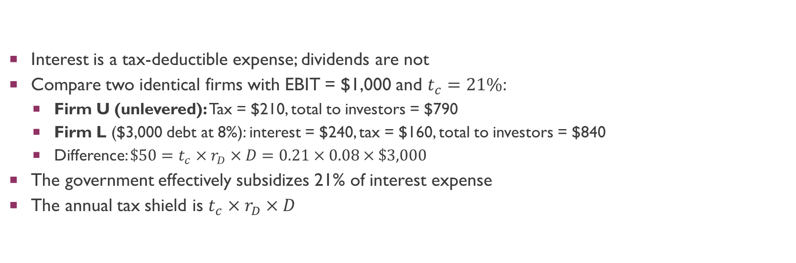
Debt and Taxes: The Interest Tax Shield
Interest is a tax-deductible expense; dividends are not
Compare two identical firms with EBIT = $1,000 and $t_{c}=21\%$:
Firm U (unlevered): Tax = $210, total to investors = $790
Firm L ($3,000 debt at 8%): interest = $240, tax = $160, total to investors = $840
Difference: $\$50=t_{c}×r_{D}×D=0.21×0.08×\$3,000$
The government effectively subsidizes 21% of interest expense
The annual tax shield is $t_{c}×r_{D}×D$

Slide 25
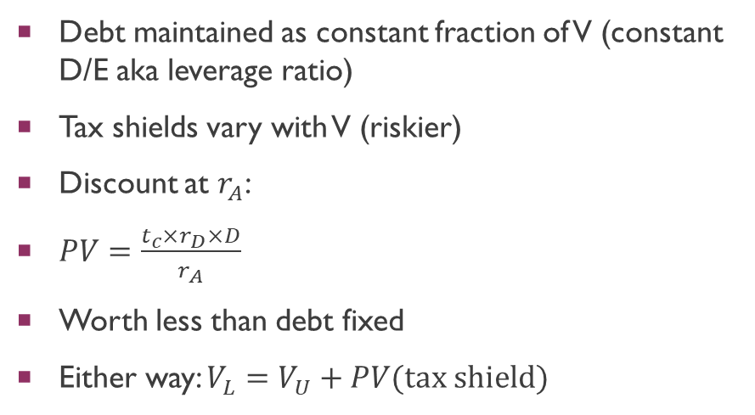
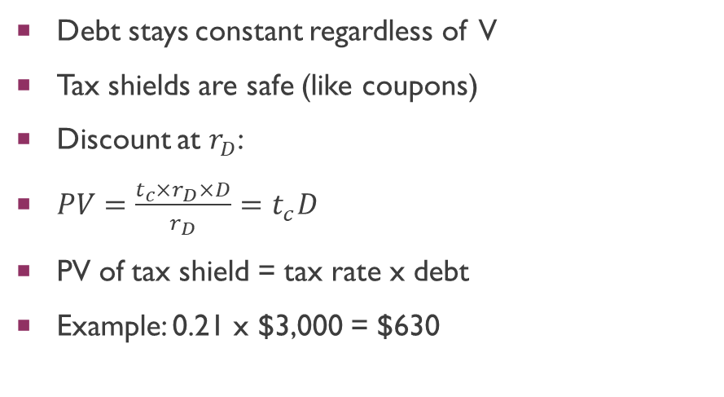
PV of Tax Shields: Two Benchmark Policies
Debt Fixed
Debt Rebalanced
Debt stays constant regardless of V
Tax shields are safe (like coupons)
Discount at $r_{D}$:
$PV=\frac{t_{c}×r_{D}×D}{r_{D}}=t_{c}D$
PV of tax shield = tax rate x debt
Example: 0.21 x $3,000 = $630
Debt maintained as constant fraction of V (constant D/E aka leverage ratio)
Tax shields vary with V (riskier)
Discount at $r_{A}$:
$PV=\frac{t_{c}×r_{D}×D}{r_{A}}$
Worth less than debt fixed
Either way: $V_{L}=V_{U}+PV(\text{tax} \text{shield})$

Slide 26
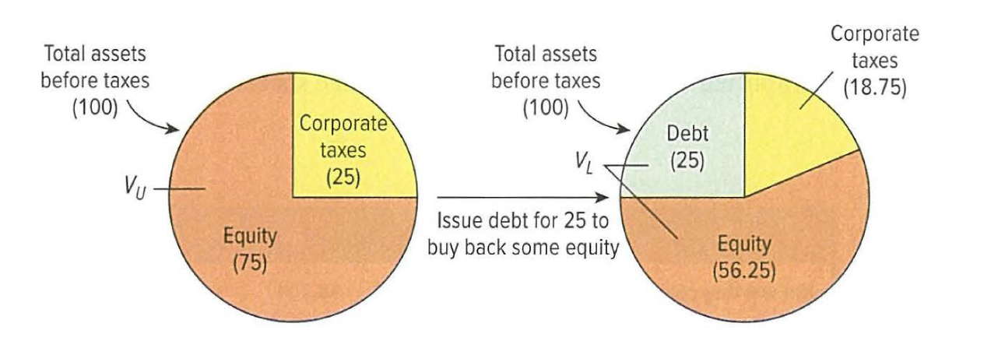
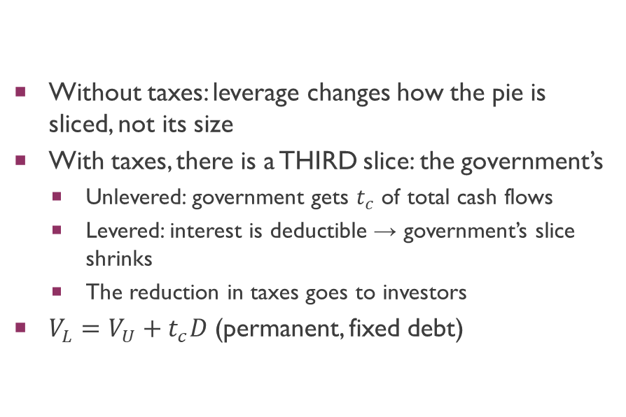
How Tax Shields Increase Shareholder Wealth
Without taxes: leverage changes how the pie is sliced, not its size
With taxes, there is a THIRD slice: the government’s
Unlevered: government gets $t_{c}$ of total cash flows
Levered: interest is deductible → government’s slice shrinks
The reduction in taxes goes to investors
$V_{L}=V_{U}+t_{c}D$ (permanent, fixed debt)

Slide 27
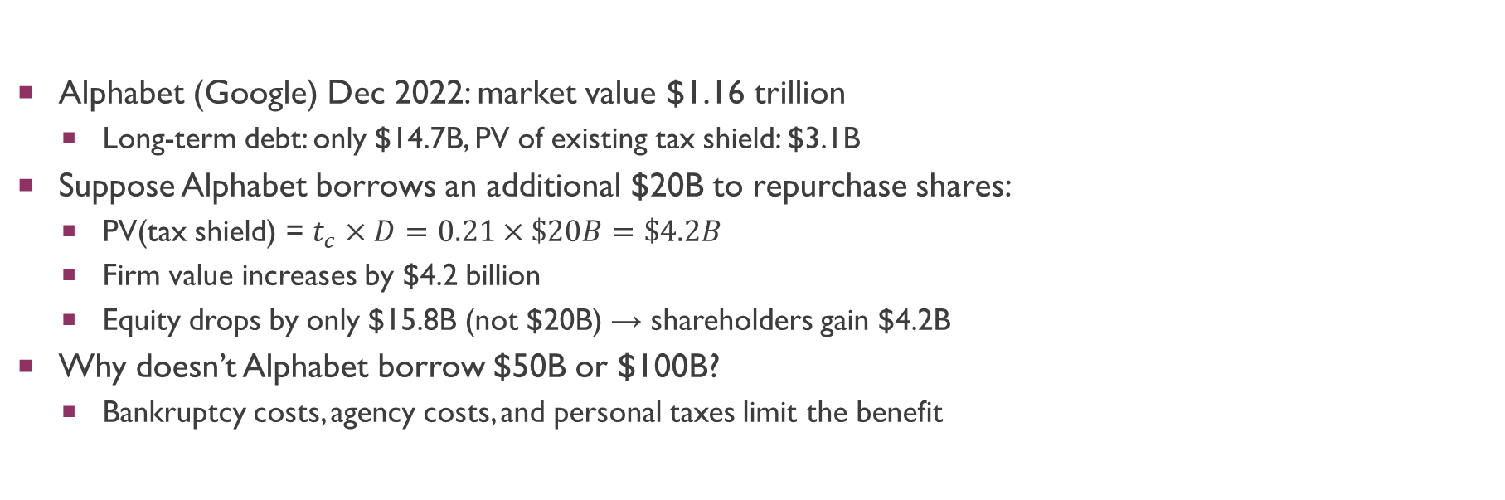
Changing Alphabet’s Capital Structure
Alphabet (Google) Dec 2022: market value $1.16 trillion
Long-term debt: only $14.7B, PV of existing tax shield: $3.1B
Suppose Alphabet borrows an additional $20B to repurchase shares:
PV(tax shield) = $t_{c}×D=0.21×\$20B=\$4.2B$
Firm value increases by $4.2 billion
Equity drops by only $15.8B (not $20B) → shareholders gain $4.2B
Why doesn’t Alphabet borrow $50B or $100B?
Bankruptcy costs, agency costs, and personal taxes limit the benefit

Slide 28
Limits to the Tax Advantages of Debt
Must have taxable profits to shield
If EBIT < interest, excess interest provides no current tax benefit
Tax loss carry-forwards help but have lower PV (some countries limit the number of years)
Interest deduction caps
US: deductible only up to 30% of EBIT
EU: 30% of EBITDA
Personal taxes can offset the corporate advantage
Interest income is taxed at the personal level
If personal tax on interest > personal tax on equity income, the net advantage shrinks

Slide 29
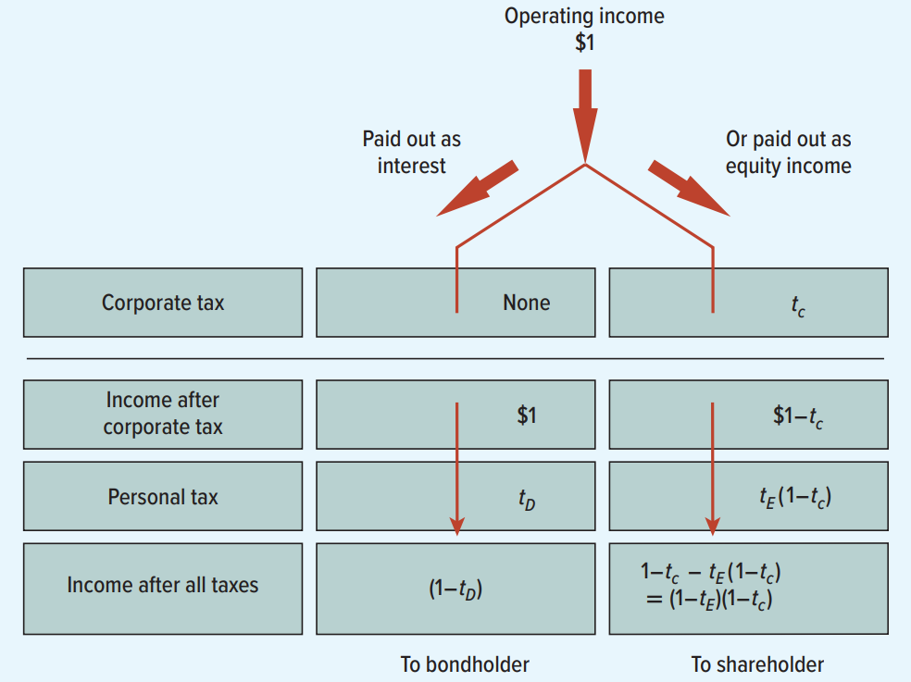
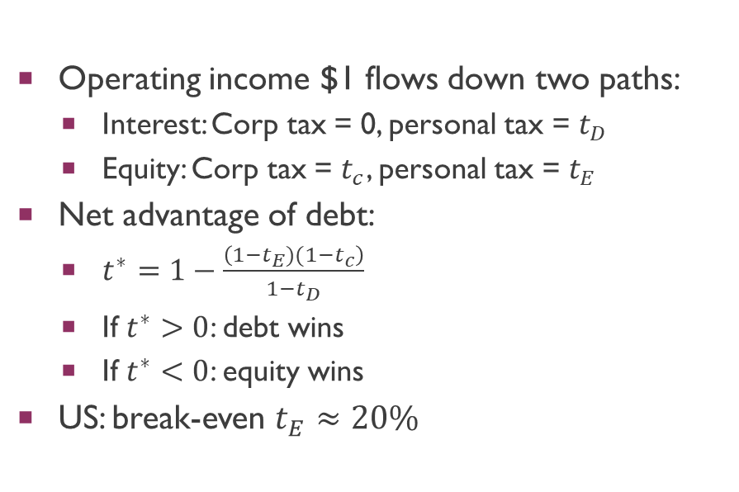
Personal Taxes and the Relative Tax Advantage
Operating income $1 flows down two paths:
Interest: Corp tax = 0, personal tax = $t_{D}$
Equity: Corp tax = $t_{c}$, personal tax = $t_{E}$
Net advantage of debt:
$t^{∗}=1−\frac{\left(1−t_{E})(1−t_{c}\right)}{1−t_{D}}$
If $t^{∗}>0$: debt wins
If $t^{∗}<0$: equity wins
US: break-even $t_{E}≈20\%$

Slide 30
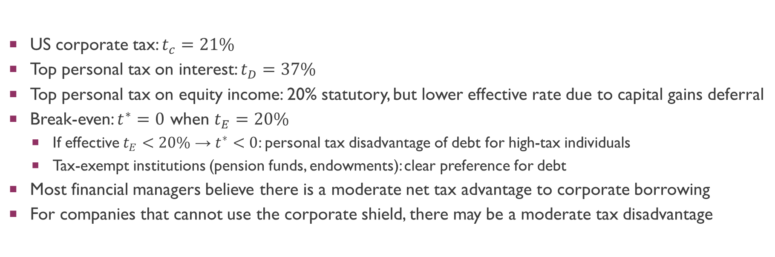
Is There a Net Tax Advantage to Debt?
US corporate tax: $t_{c}=21\%$
Top personal tax on interest: $t_{D}=37\%$
Top personal tax on equity income: 20% statutory, but lower effective rate due to capital gains deferral
Break-even: $t^{∗}=0$ when $t_{E}=20\%$
If effective $t_{E}<20\%$ → $t^{∗}<0$: personal tax disadvantage of debt for high-tax individuals
Tax-exempt institutions (pension funds, endowments): clear preference for debt
Most financial managers believe there is a moderate net tax advantage to corporate borrowing
For companies that cannot use the corporate shield, there may be a moderate tax disadvantage

Slide 31
Clientele Effects
Some investors cannot borrow as cheaply as corporations
They may prefer levered companies for the higher returns
This creates a clientele of investors who favor corporate debt
But as firms respond by levering up, supply adjusts to meet demand
Once supply matches the clientele’s demand, no individual firm can add value by changing its leverage
Clientele effects explain why some firms use debt, but not that all should

Slide 32

What Are Bankruptcy Costs?
Devonshire: V = $100, D = $50, E = $50. Recession → V drops to $30
Debtholders owed $50, recover only $30; equityholders get $0 (limited liability)
Bankruptcy is costly not because of the recession, but because of the bankruptcy PROCESS:
Legal fees: courts, lawyers for each class of claimants
Enron: $757M in professional fees; Lehman Brothers: $5.9B
Fire sale discounts: assets sold quickly at deep discounts
Lehman: $60B recovered was $11B less than estimated value
Loss of intangible assets: employees leave, brand erodes, R&D abandoned, customer relationships severed
Average direct costs: ~3% of book assets, ~20% of equity value

Slide 33
Costs of Financial Distress (Pre-Bankruptcy)
Even without actual bankruptcy, the mere POSSIBILITY of default erodes firm value
Customers worry about warranties, service, and resale value
Chrysler saw plummeting sales before its 2009 bankruptcy — buyers feared the company wouldn’t honor warranties
Suppliers demand cash upfront or refuse trade credit
Creates a liquidity squeeze at the worst possible time
Employees leave for safer employers; stop investing in firm-specific human capital
These indirect costs can far exceed the direct legal fees of bankruptcy

Slide 34
Bankruptcy Costs Vary with Asset Type
Heartbreak Hotel (tangible)
Digital Organics (intangible)
Recession: default on mortgage
Lender sells to new operator
Hotel worth almost the same
Bankruptcy costs are minimal
Tangible assets survive well
This is why airlines can borrow heavily
Employees walk away
Technology is specialized, hard to sell
Half-finished R&D is worthless
Going concern value destroyed
This is why tech/pharma firms use little debt
Do not think only about the probability of bankruptcy — think also of the value that may be lost

Slide 35

Agency Costs of Equity
Arise when managers have too little equity stake in the firm
Example: Stevie starts $10M business with only $1M of own money
Owns 10% → bears only 10% of costs, gets only 10% of benefits
Free cash flow problem: empire building, perks, reduced effort
How debt helps:
Concentration: higher leverage → larger ownership fraction
Reduced free cash flow: interest commits cash outflows, harder to waste
Discipline: must generate enough cash to cover interest or face bankruptcy
Debt alleviates agency costs of equity, but creates its own agency costs...

Slide 36
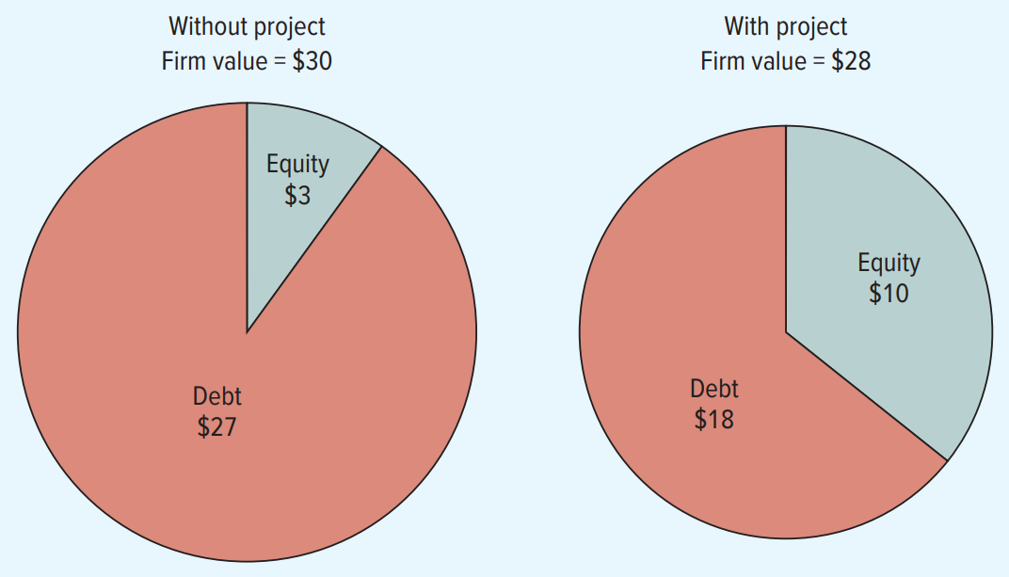
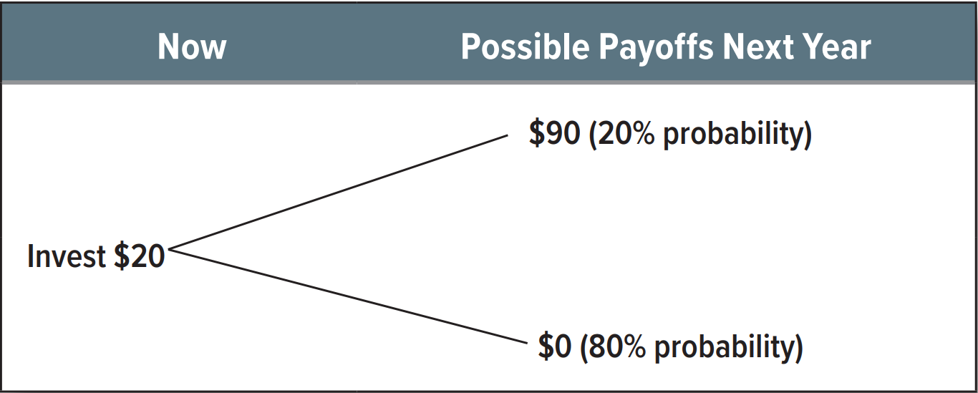
Agency Costs of Debt: Risk Shifting
NPV =$100(20%) + $10(80%) = $28
$28 < $30, NPV = -$2
But shareholder sees:
Succeeds: E jumps $3 to $50
Fails: loses only $3 (limited liability)
Shareholders gamble with debtholders’ money
Circular File: V = $30, D = $27, E = $3, Cash = $20, Fixed Assets = $10.
Firm owes debtholders $50.
Negative-NPV gamble: invest $20
20% chance: $90 (V = $10 + $90 = $100)
80% chance: $0 (V = $10 + $0 = $10)
20% chance
Debt : $27 + $23 = $50
Equity : $3 + $47 = $50
80% chance
Debt: $27 - $17 = $10
Equity: $3 - $3 = $ 0 (limited liability)

Slide 37
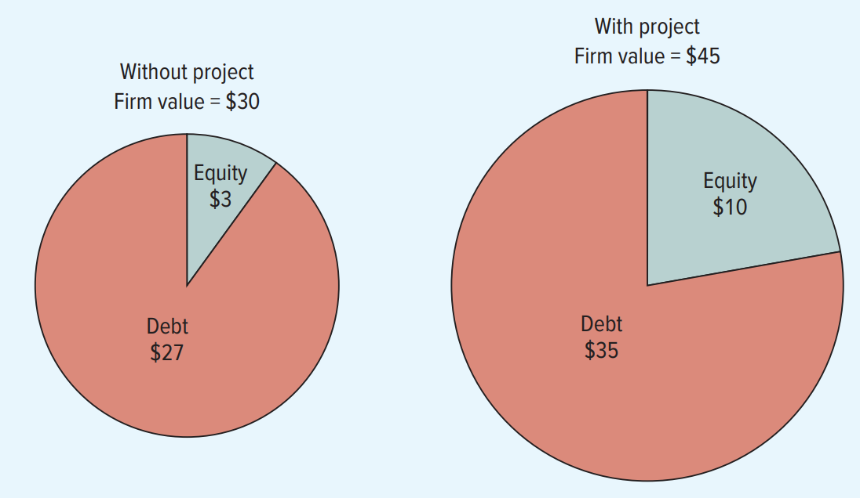
Agency Costs of Debt: Debt Overhang
Circular File finds a good project (read textbook to ascertain values):
Invest $30 → assets worth $35, NPV = +$5
Shareholder must contribute $10 new equity
V rises from $30 to $45
Debt rises from $27 to $35 (+$8 windfall)
Equity rises from $3 to $10 (+$7 gain on $10 invested)
Shareholder puts in $10 but gains only $7
The $8 windfall to debtholders acts like a tax
Shareholder declines the positive-NPV project!

Slide 38
What the Games Cost
Bondholders are NOT fooled — they anticipate risk shifting and debt overhang
They respond by demanding higher interest rates or imposing covenants
Covenants restrict dividends, additional borrowing, asset sales, and investment
But covenants are blunt instruments: cannot be written on NPV
May inadvertently prevent positive-NPV projects
Like traffic lights: prevent all driving, not just dangerous driving
The incidence of these costs falls on shareholders through higher interest rates and tighter restrictions
Maximizing shareholder value therefore requires limiting debt

Slide 39
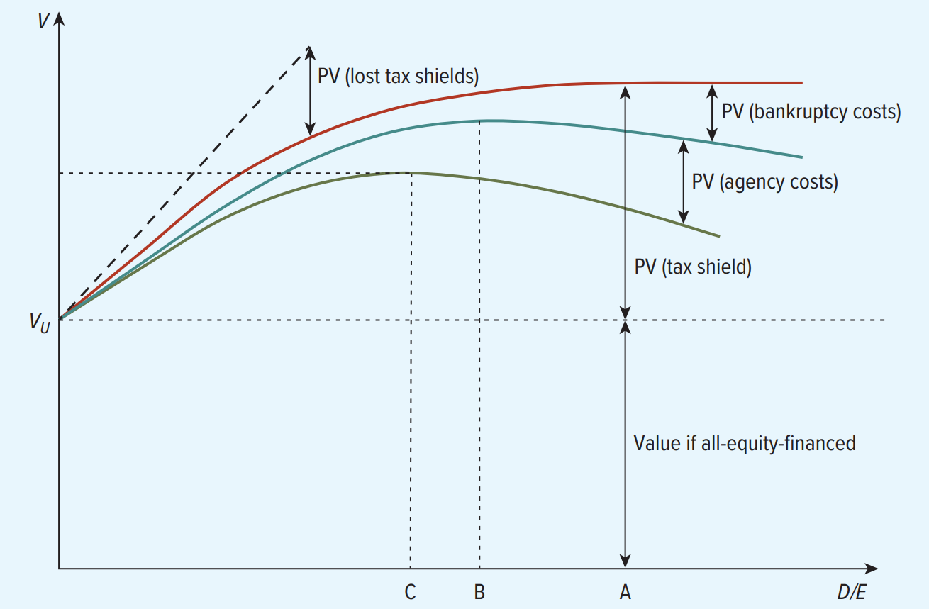
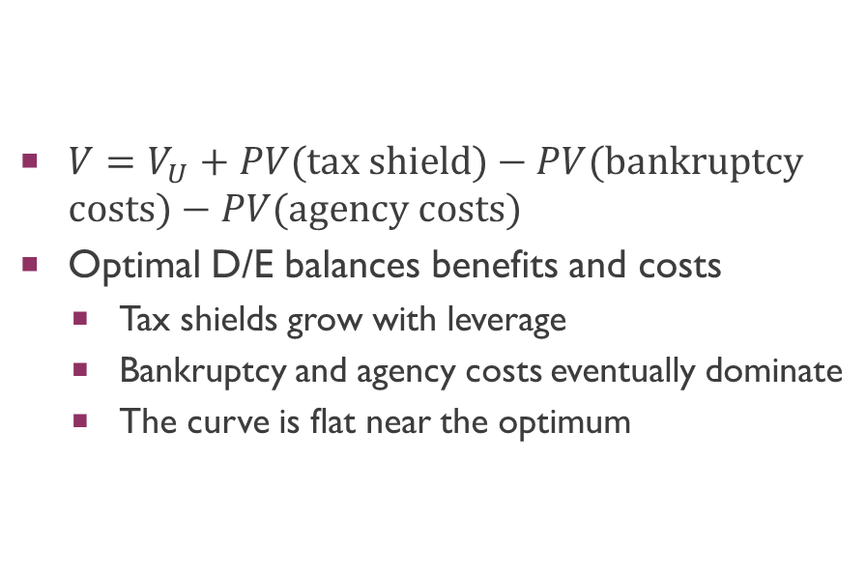
The Trade-Off Theory of Capital Structure
$V=V_{U}+PV(\text{tax} \text{shield})−PV(\text{bankruptcy} \text{costs})−PV(\text{agency} \text{costs})$
Optimal D/E balances benefits and costs
Tax shields grow with leverage
Bankruptcy and agency costs eventually dominate
The curve is flat near the optimum

Slide 40
Trade-Off Theory: Predictions
Costs and benefits of debt vary by firm → optimal D/E varies by firm:
Profitable firms should borrow more (more profits to shield)
Safer firms should borrow more (lower bankruptcy probability)
Tangible assets → borrow more (lower distress costs; e.g. airlines vs. biotech)
Fewer growth opportunities → borrow more (lower agency costs of debt; lower costs of financial distress)
Evidence:
Implications 2, 3, 4 are generally supported
Implication 1 is contradicted: most profitable firms borrow the LEAST
65% of small firms and 91% of large firms report target debt ratios
The trade-off curve may be flat near the optimum → little cost to deviating

Slide 41
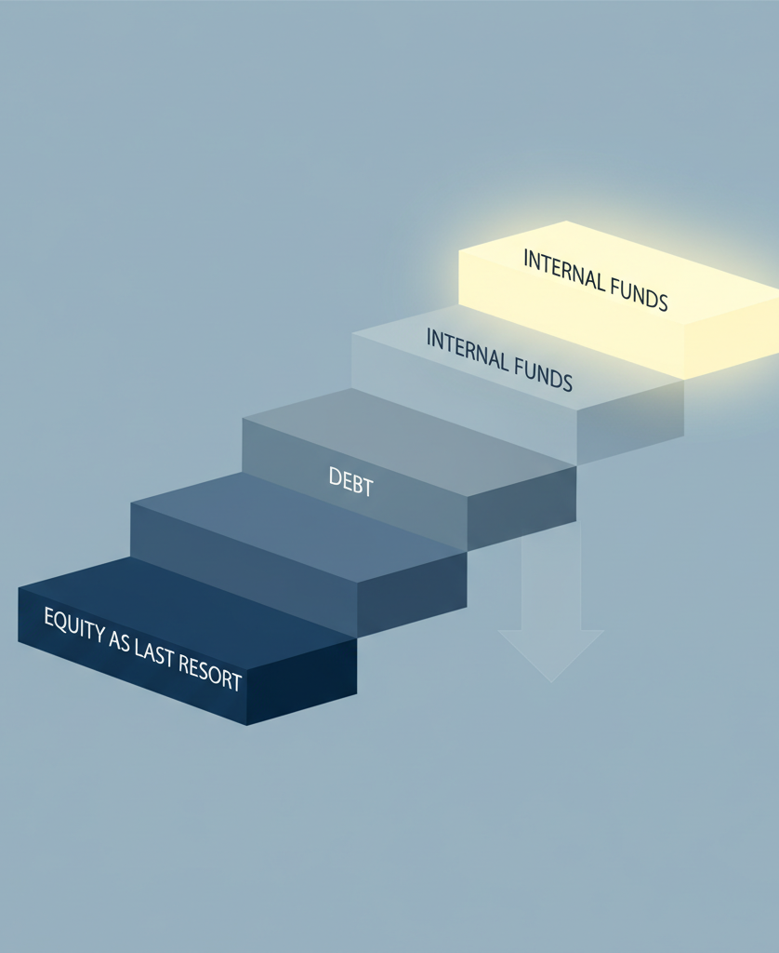
The Pecking Order Theory
Built on asymmetric information: managers know more than outside investors
We observe this: stock prices react to financing announcements
Dividend increases signal confidence → stock price rises
The signaling problem with equity issuance:
Optimistic manager (stock undervalued): refuses to sell underpriced shares → issues debt
Pessimistic manager (stock overvalued): eager to issue equity at the inflated price
Investors learn this → equity issuance is interpreted as bad news
Result: smart managers of BOTH types end up issuing debt

Slide 42
The Issuance Decision: Smith & Jones
Two identical companies, stock priced at $100. True value could be $80 or $120.
Both need $120M to fund investment. Which security do they issue?
Jones Inc. (optimistic — true value = $120):
“Sell shares at $100? They’re worth $120! Issue debt instead.”
Smith & Co. (pessimistic — true value = $80):
“Stock trades above true value. Now’s the time to sell equity.”
What investors infer from the announcement:
Jones issues debt → she’s optimistic → good signal
Smith issues equity → he’s pessimistic → bad signal
Both end up issuing debt! Equity is a last resort because of the negative signal it sends

Slide 43
The Pecking Order of Financing
Internal funds (retained earnings) — no information costs, no signal, no underpricing
Debt — minimal information asymmetry (debt is a relatively safe claim)
Equity — last resort only (sends a negative signal to the market)
There is no well-defined target debt ratio — observed leverage reflects cumulative financing needs:
High-profitability firms: generate cash internally → low leverage
Medium-profitability: need external funds → issue debt → high leverage
Low-profitability: exhaust debt capacity → forced to issue equity
Explains why the most profitable firms borrow the least (trade-off theory cannot)

Slide 44
Financial Slack: Bright Side and Dark Side
Financial slack: cash in the bank or ready access to debt markets
Bright side: firms can seize positive-NPV opportunities quickly without information costs
Growth companies aspire to conservative capital structures to maintain slack
“Raise capital when you can, not when you need it”
Companies typically issue equity before major multi-year capex programs
Dark side: too much slack → agency costs of equity
Surplus cash tempts managers to overinvest (empire-building)
Debt can discipline managers by forcing cash outflows
Ideal: enough cash to finance all positive-NPV projects, with not a penny left over

Slide 45
The Capital Structure Decision: What the Evidence Says
Four key determinants of debt ratios across seven economies (Rajan & Zingales, 1995):
1. Size (+): large firms borrow more — lower distress costs, more diversified
2. Tangible assets (+): better collateral, lower distress costs
3. Market-to-book (–): growth firms borrow less — higher distress costs, more agency problems
4. Profitability (–): more profitable firms borrow less — the key puzzle
Trade-off theory explains #1, #2, #3 but FAILS on #4
Predicts profitable firms should borrow MORE to use tax shields
Pecking order explains #4 (profitable firms have internal funds) but lacks a target ratio
Fits best for large, mature firms with bond market access
There is no single, unified theory of optimal capital structure

